Slide 1

BUSINESS SERVICE PRICE INDEX
Office of Economic Advisor
Ministry Of Commerce and Industry
Government of India
New Delhi

Slide 2
Introduction
India’s GDP growth since the 90’s has been led by services sector.
Service sector has had a growth of 10.3% in 2014-15, 8.9% in 2015-16 and further to 8.8% in 2016-17 at basic prices.
Service sector accounted for 53.8% of GVA at constant prices during the year 2016-17.
Currently India estimates Wholesale Price Index which covers only goods and not services.
Decision to include service sector prices in PPI in India taken in principle
Currently development of business service sector price indices is at an experimental stage.

Slide 3
Current Status of Development of Business Service Price Index In India For Inclusion In WPI/PPI
Decision to cover ten broad business services initially in India
  Railways
  Air Transport
  Postal
  Telecommunication
  Banking
  Insurance
  Road transport
  Port
  Trade
  Business Services
Fixed base Laspeyres’ method has been used in all cases as is currently being done for Wholesale Price Index estimation

Slide 4
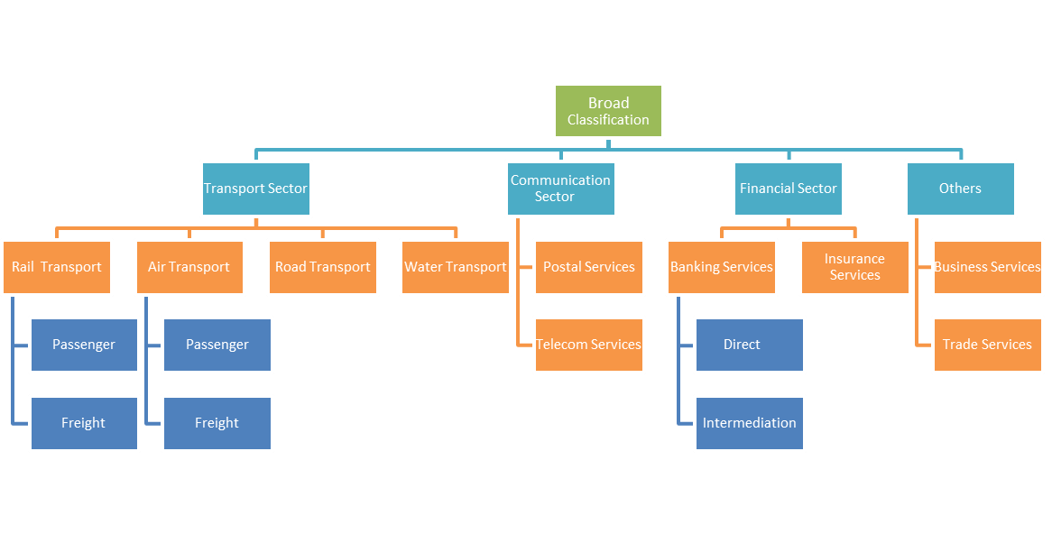
Overview of Proposed Service Price Index
All indices are expected to be integrated as per the following framework:

Slide 5
Railway Service Price Index
Railway Service Price Index
Base Year | 2004-05
Frequency | Monthly
Components | Passenger service and freight service
Weighting diagram | Weights assigned on the basis of relative shares of the two components in traffic earnings.
Price of freight service | Total revenue earning from freight service/ Total tonne Km
Inter se weight for freight service | Based on share of different commodities by tonne Km in total tonne Km of all commodities transported through railways
Price for passenger service | Total revenue earnings from passenger service/ Total passenger Km
Inter se weight for passenger service | Based on share of different classes of passengers (economy, premium) by passenger Km in total Passenger Km of passenger transport service.
Data availability so far | April 2005 to Feb 2017
Data sources | Railway Board, Ministry of Railways

Slide 6
Railway Service Price Index
Challenges
Administered price data is considered from Ministry of Railways.
For some routes rail fares are set on a dynamic basis and therefore difficult to capture in index movement
Unit Price is being used for calculation of indices,
Alternate method of web-scrapping is not popular in official statistics in India.
Metro railway network is increasing in India and its not covered in the basket

Slide 7
Banking Service Price Index
Banking Service Price Index
Base Year | 2004-05
Frequency | Monthly
Components | Direct services (for which bank charges fees, commissions and brokerages) and Intermediation services (accepting deposits and giving loans and advances)
Price of Direct service | Fees, commissions, brokerages charged by the banks
Price for Intermediation services | Loan price = Interest rate received on loans- reference rate
 | Deposit price = Reference rate - Interest rate paid on deposits
 | Weighted average yield to maturity (YTM) of Central Government securities with residual maturity between 1 and 5 years be used as a reference rate.
Weighting diagram | The weighting diagram used for the intermediation services is calculated as the average of the amount outstanding as on 31st March 2004 and 31st March 2005 and for the direct services, it is calculated on the basis of total income from these services during the year 2004-05.
Data availability | April 2004 to May 2017
Data Sources | Reserve Bank of India (BkSPI developed on the basis of 28 selected commercial banks and 2 co-operative banks.)

Slide 8
Banking Service Price Index
Challenges
Brokerage income of banks not covered in basket
  Contribution of third party commission to banks for selling insurance, mutual funds
    this is the money invested by banks for their clients - account holders with full consent
    but once invested, banks churn by buying and selling schemes
    they get a 3% upfront that they negotiate with the fund house
    with NIM under pressure, a bulk of the bank bottom-line is being funded by commissions.

Slide 9
Banking Service Price Index
Coverage of new banks- IDFC, Bandhan, Mudra and payment banks
New products by the banking sector not covered in the basket
Bank sponsored wallets
  ICICI Pockets, Axis Lime, HDFC PayZapp, SBI Buddy
Third party wallets
  PayTM, PayUmoney, Oxigen, Citrus Pay
E-Commerce wallets
  Flipkart Wallet, Ola Money
Mobile Operators’ wallets
  Airtel Money, Vodafone M pesa, Idea Money

Slide 10
Postal Service Price Index
Postal Service Price Index
Base Year | 2004-05
Frequency | Monthly
Components | Postal Services related to letters Postal services related to Parcels Post Office counter services (Sale of Stamps, handling of registered letters and packets)Other services (Speed Post, Express Post, Business Post, Bill Mail Service, e-post etc)
Price | Since the tariffs/charges are weight sensitive and/or distance sensitive all the tariffs/charges classified by different categories within a service have been treated as different entities e.g. an envelope with weight up to 20 grams has been treated as a separate entity than an envelope in excess of 20 grams.
Weighting diagram | Weights assigned on the basis of estimated revenue of each item
Data availability | April 2005 to June 2017
Data source | Department of Posts

Slide 11
Postal Service Price Index
Challenges
Coverage limited only to postal services rendered by Government department
Prices are administered as a result the index does not show any significant change
Private sector, in particular courier services, not covered

Slide 12
Telecom Service Price Index
Telecom Service Price Index
Base Year | 2009-10
Frequency | Monthly
Components | Telephone call and Short Messaging Service
Price of Call | Average Subscriber Outgo per Outgoing Minute
Weight of call | Weights to the item call have been assigned on the basis of the share of the estimated revenue of calls to the total revenue generated in call and SMS categories.
Price of SMS | Derived as the average revenue per subscriber per SMS
Weight of SMS | Weights to the items SMS have been assigned on the basis of the share of the estimated revenue of SMS item to the total revenue generated in call and SMS categories).

Slide 13
Telecom Service Price Index
Telecom Service Price Index
Final weighting diagram | The index is first compiled at the item level, for both GSM & CDMA services. Then, the GSM & CDMA services are combined by allocating the weight to GSM & CDMA categories on the basis of estimated revenue in the base year.
Data availability | April 2009 to May 2017
Data source | Telecom Regulatory Authority of India

Slide 14
Telecom Service Price Index
Challenges
Sector is highly competitive and specifications of products and prices change very frequently
Predatory pricing is very common as a result it is difficult to reflect genuine price movement of telecom services
Challenges of pricing bundled products in particular data services and value added services

Slide 15
Air Service Price Index
Air Service Price Index
Base Year | 2009-10 (Proposed to be rebased at 2015-16 prices)
Frequency | Monthly
Components | Passenger services Freight services
Routes | 41 passenger routes and 21 freight routes were selected for 2015-16. The selected passenger routes covers about 65% of total pax volume.
Price of freight service | Unit price is arrived by dividing total monthly revenue earning for a selected airline by total monthly Tonne Km. for the airline.
Weight of freight service | Weights are assigned to the routes based on Passenger Km
Price for passenger service | Unit price is arrived by dividing total monthly revenue earning in a route of the selected Airline by total monthly passenger Km of the route
Weight of passenger service | Weights are assigned to the routes based on Tonne Km.

Slide 16
Air Service Price Index
Air Service Price Index
Weighting diagram | For developing composite index, the weights for passenger and freight services are arrived by dividing the revenue earned in these services by total revenue earned by both services put together respectively.
Data availability | April 2011 to Dec 2016

Slide 17
Air Service Price Index
Challenges:
Inclusion of more routes and other airlines
Unit Price is being used for calculation of indices, alternate method of web-scrapping not popular in official statistics
Airlines reluctant to share prices because of competition

Slide 18
Insurance Service Price Index
Insurance Service Price Index
Base Year | 2010-11
Frequency | Quarterly
Components | Life Insurance Non-life Insurance
Price of insurance service | Price for insurance services is calculated as the ratio between (Operating expenses + Profits + Commissions) and (Premium + Investment Income)
Weight of Life and Non-Life Insurance | Weights are assigned to Life and Non-Life Insurance services on the based on the Gross Value Added (GVA) weightage computed by National Accounts Division (NAD), MoSPI
Data availability | April 2011 to September 2016
Data sources | Insurance Regulatory and Development Authority of India

Slide 19
Insurance Service Price Index
Challenges
Difficulty in segregating pure insurance services.
Insurance industry in India produces bundled (hybrid) financial products comprising of savings, investment, and pension element beneath a thin crust of insurance.

Slide 20
Road Transport (Freight) Service Price Index
Road Transport (Freight) Service Price Index
Base Year | 2015-16
Frequency | Monthly
Components | Fuel Charges Rubber Tyres cost Expenses (Maintenance, insurance, overheads) Investment (Prices of Trucks) Government Taxes (National permit, road tax, fitness) Human Service (Driver’s salary) Toll Charges
Price | The price will be calculated by adding a mark-up value to the developed CRI to convert the cost into sale price.
Weights | Weights are assigned according to number of Vehicles in different Gross Vehicle Weight (GVW) category for constructing the Index.
Issues | The mark-up value was said to be based on personal internal knowledge of the transporters and no clear statistical estimation procedure was used in its calculation.
Status | Continuous discussions are being held with TRW and AITWA to bring clarity to the proposed mark-up value.

Slide 21
Road Transport (Freight) Service Price Index
Challenges
Results based on cost plus method not convincing
Alternative method of collecting freight rates directly has practical difficulties due to road sector being highly unorganized

Slide 22
THANK YOU
Presented by:
Mr. Gopal Singh Negi, Economic Advisor
E-mail: gopal.negi@nic.in
Mr. Anupam Mitra, Additional Economic Advisor
E-mail: anupam.mitra@gov.in

